Slide 1





Jedi-07 Group 2
Course Registration System

Slide 2
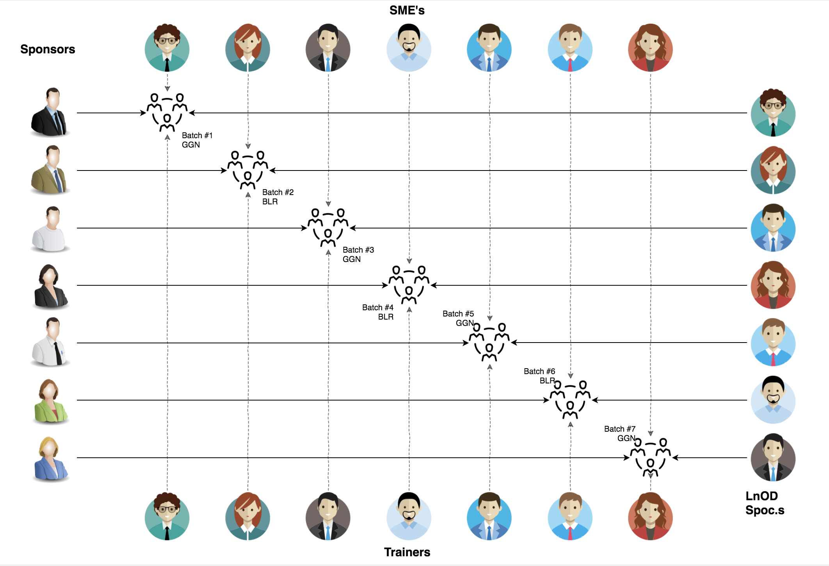
Stakeholders
Sponsors
Flipkart
SME's
Deepika Gajraj
Khushboo (order trainings)
2
Trainer
Amit Balyan

Slide 3

Agenda
01
Our Team
02
Our Journey
03
Contribution
04
Problem Statement
05
Engineering Practices
06
Tech Stack
07
Demo
08
Learnings
09
Challenges
10
Questions
Notes:
Time – 1 min

Slide 4
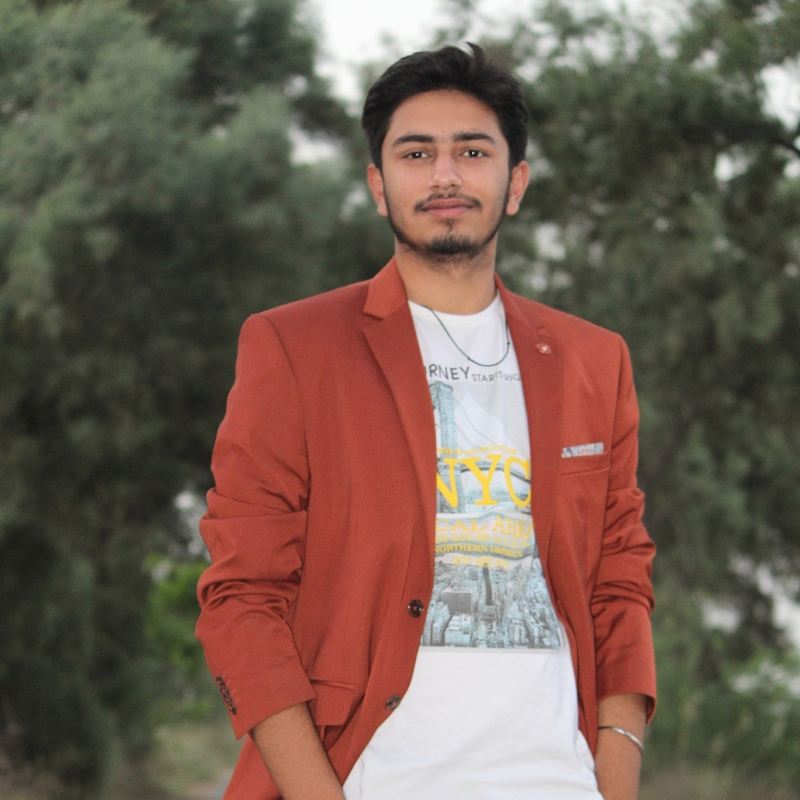
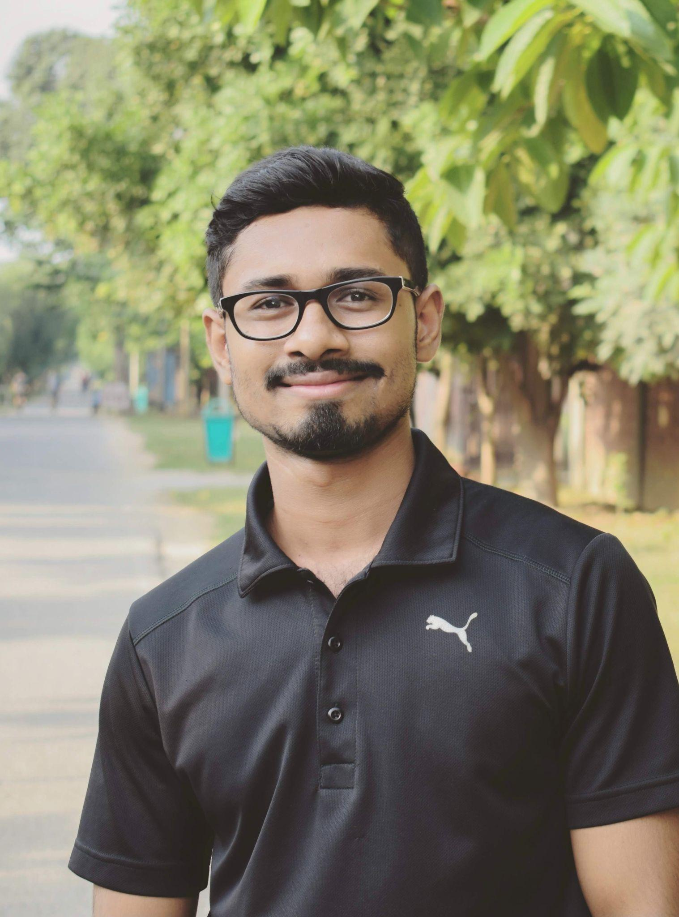
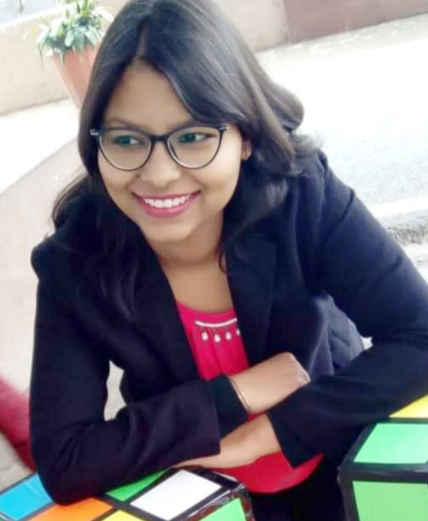
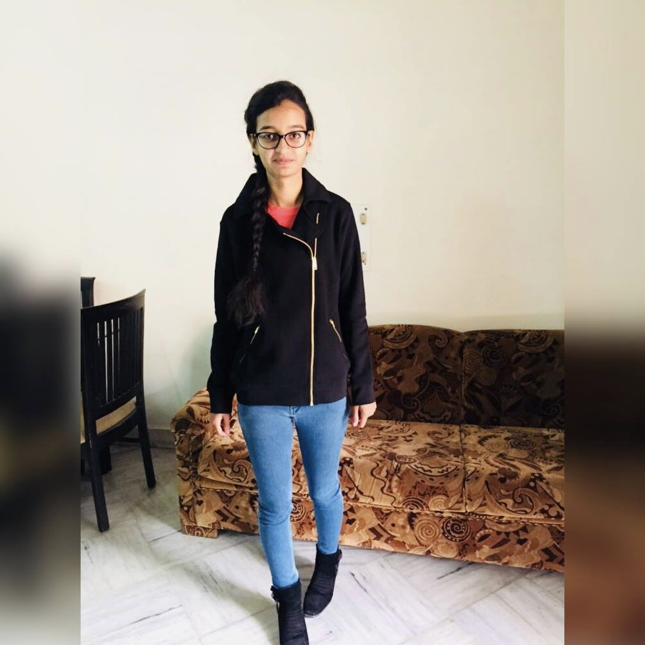
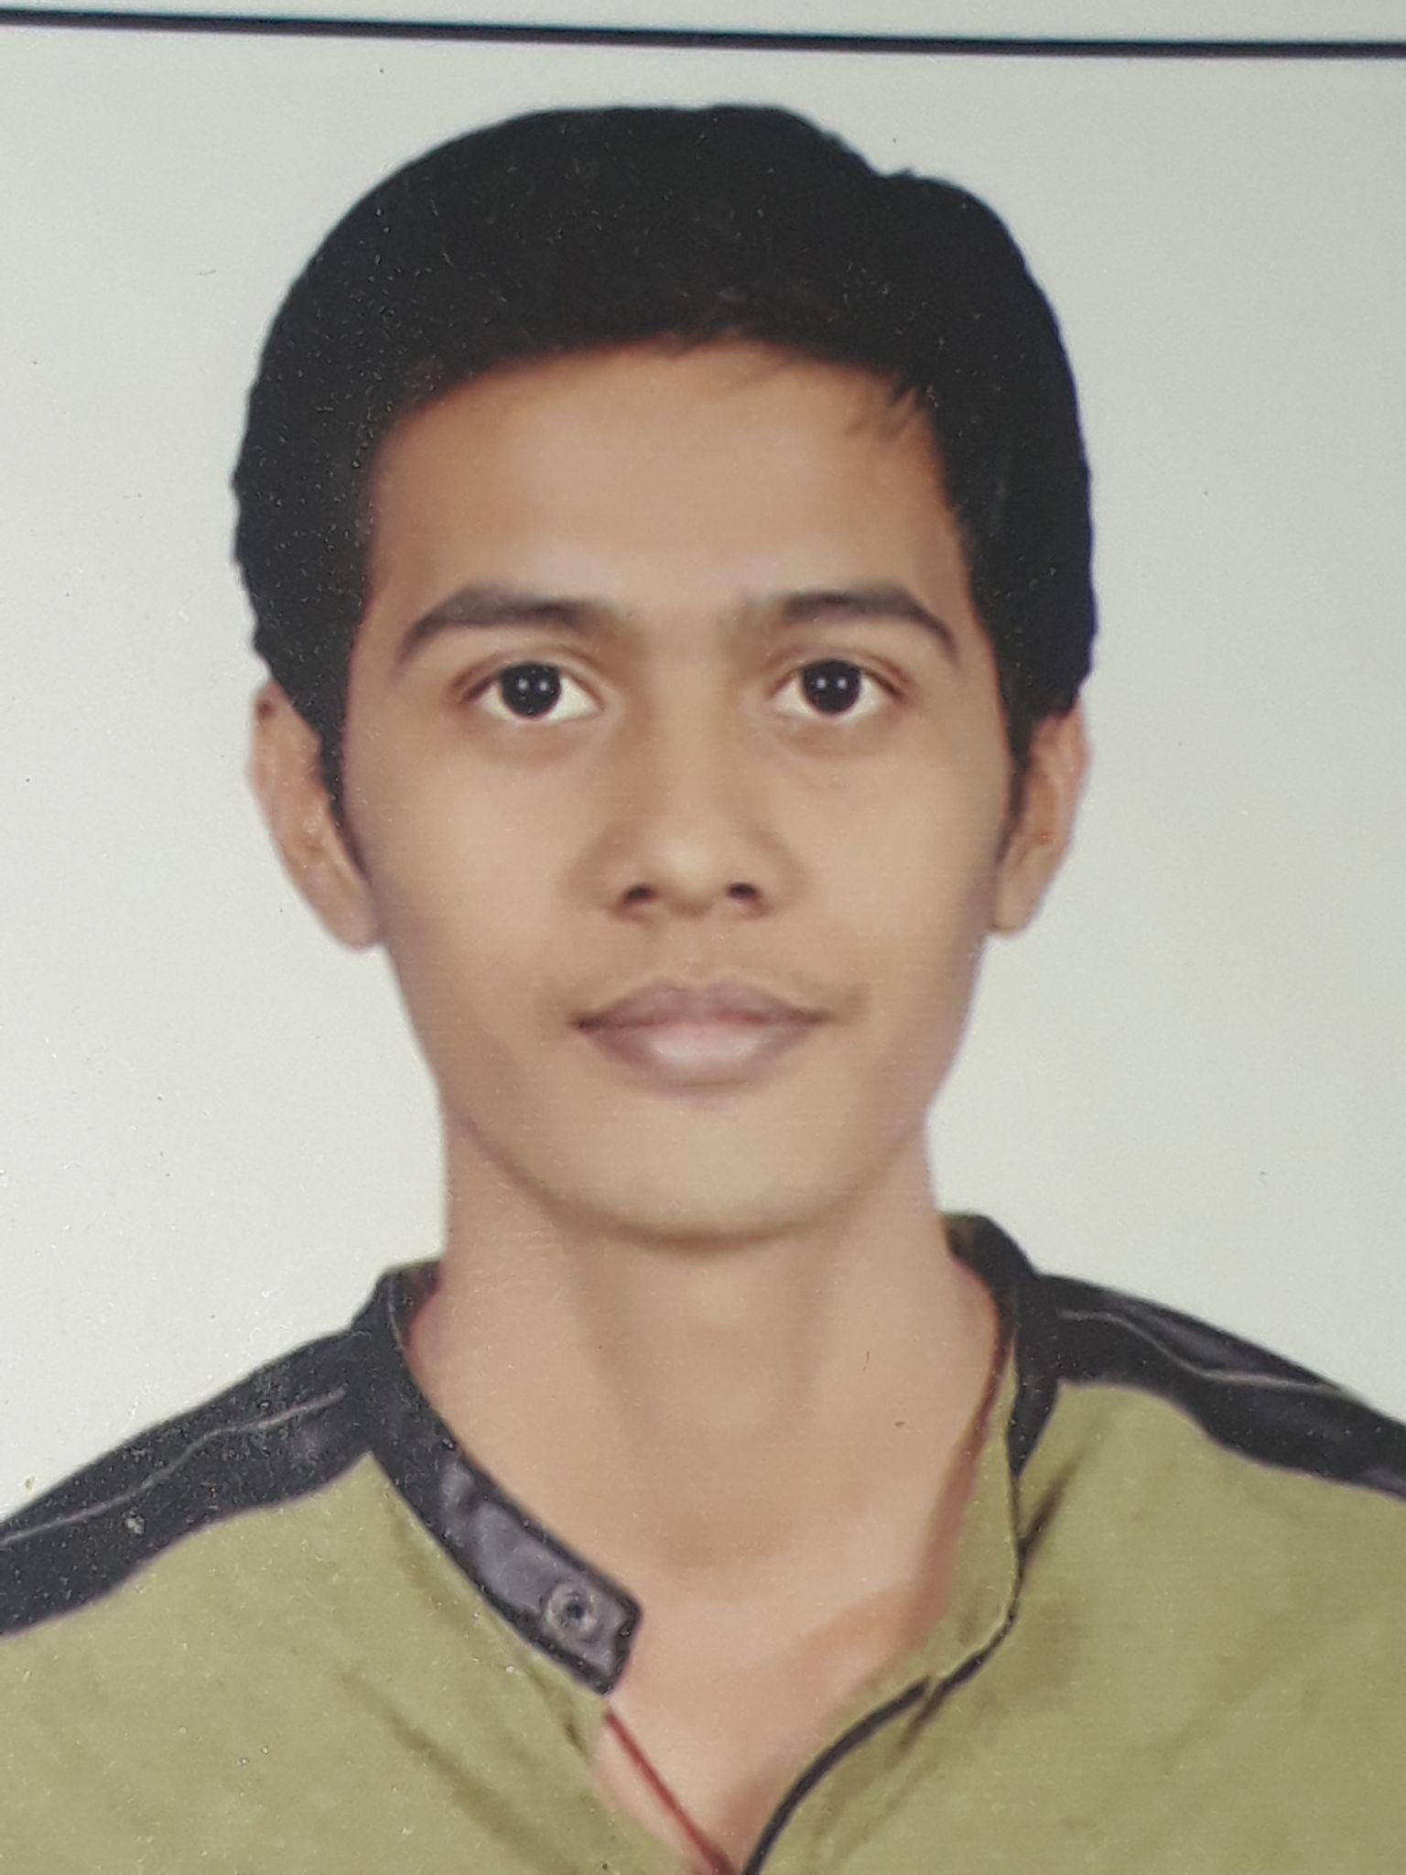
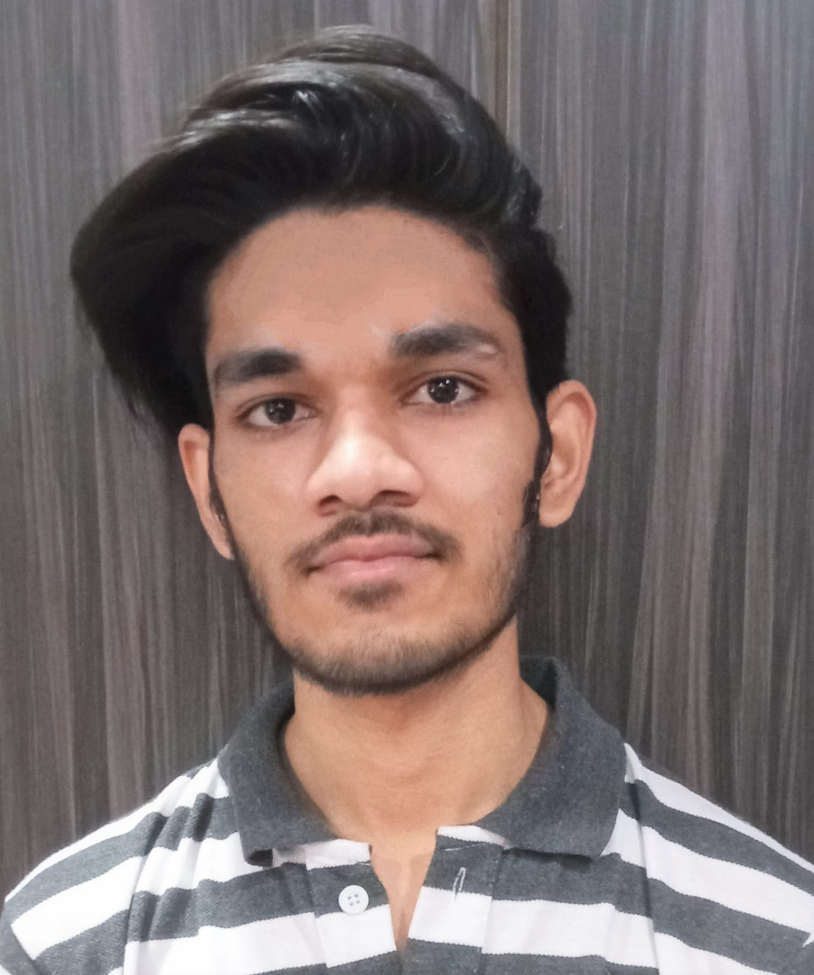
Bharat Ranjan
[Team Lead]
Kishan Kumar Roy
[Always at 110%]
Mansi Goel
[Lead Helping Hand]
OUR
TEAM
Jashpreet Kaur Malhotra
[Mountain Mover]
Ganesh Mundra
[Difference Maker]
Mohd Zeeshan
[Ultimate Team Player]

Slide 5

Our Journey
Notes:
Time - 2 mins

Slide 6
2 WEEKS OF TRAINING + PROJECT DEMO
12 DAYS
96 HOURS
5760 MINUTES
345600 SECONDS
LIMITLESS KNOWLEDGE

Slide 7
01.
02.
Unix & Git
UML Diagrams
Understanding Unix and Git Commands
Requirement Understanding and diagram design
04.
03.
Java 8
POS Application & SQL
Developing a POS application using Java and MySQL
Understanding basics of java and exception handling
Action Plan
05.
06.
Java REST
Understanding about Java RESTful services
Jersey & DropWizard
REST API development using jersey and DropWizard

Slide 8
Contribution:
Name | Responsibility
Bharat Ranjan | Implemented Admin functionalities, Use case Diagram, Integration, Testing,
Kishan Kumar Roy | Implemented Admin functionalities, Activity Diagram,Testing, Documentation
Mansi Goel | Implemented Professor functionalities,Class Diagram,Testing
Jashpreet Kaur Malhotra | Implemented Professor functionalities,Class Diagram,,Testing
Ganesh Mundra | Implemented Student functionalities, Sequence Diagram,Testing
Mohd Zeeshan | Implemented Student functionalities, Sequence Diagram,Testing

Slide 9


Contribution:
PROJECT GOALS

Slide 10
Problem Statement
Entities involved are: Student, Professor, Admin
Students should be able to Register for courses and view an electronic report card at the end of the semester.
Professors access the system to choose and teach courses, record grades.
The Admin should be able to Approve a Student, Register a Professor, add/remove course from course catalog.
The System should allow students to select courses. Students can add/drop courses.
Course offerings should have a maximum of ten students and a minimum of three students.
After the registration, the system sends information to the billing system so that the student can be billed for the semester.
Create
a
Course Registration System

Slide 11




Our Vision
To create a Course Registration System using JAVA/REST tools and technologies, where a professor as well as a student can view courses and enroll in some of the courses.
1
2
Quality
Security
3
4
Interactivity
Speed
Notes:
User satisfaction and brand value

Slide 12

Engineering
Practices

Slide 13
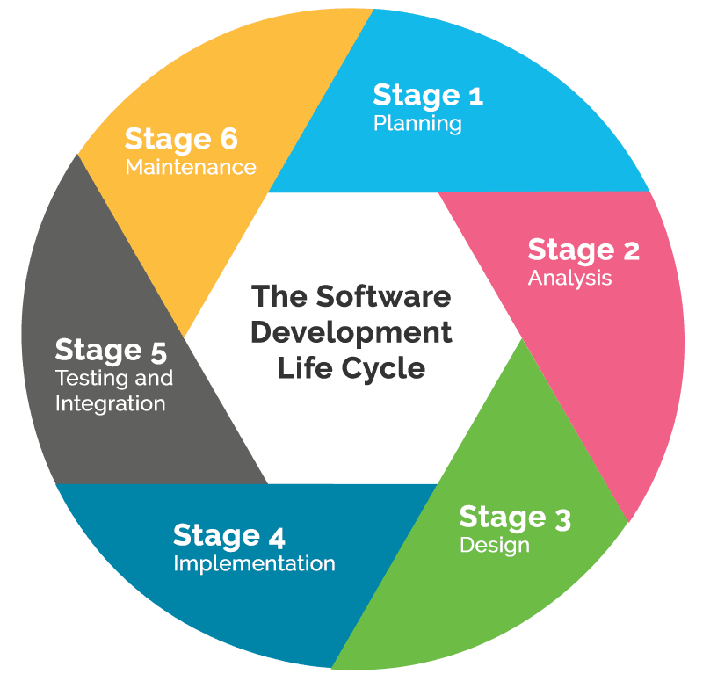
Requirement Gathering
Tech Stack Selection
Testing & Bug Fixes
UML Artifacts, Architecture Design
Code development

Slide 14





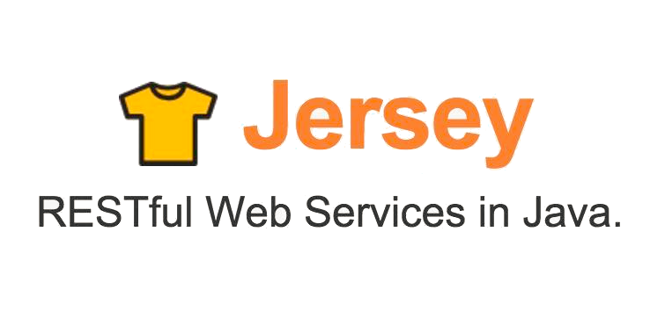


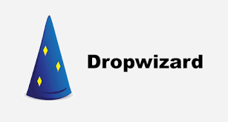



Slide 15

ARCHITECTURE DESIGN

Slide 16

SYSTEM ARCHITECTURE
HTTP Request
HTTP Response
Java Main Class(UI)
Business Class(BC)
Database Class(DAO)

Slide 17


UML Artifacts
POS Application
Rest Application
Dropwizard Application
Git repo - https://github.com/bharat-121/Flipkart-JEDI-7-Group-2

Slide 18

LEARNINGS AND CHALLENGES

Slide 19
LEARNINGS
Familiarization with Unix Commands.
Getting hang of the basic Git commands.
Software Development Life Cycle.
Knowledge and Implementation of Activity, Sequence and Use Case Diagram.
Java 8 features.
Integration of REST Services with Java code using Tomcat and Jersey.
Dropwizard Integration and Advantages.
Usage of Postman for testing APIs.
Javadoc Generation & basic Application Monitoring.

Slide 20
Understanding the problem statement and initial implementation using Use Case, activity, sequence and class diagram.
Installing software on multiple environments.
Git merge conflicts.
Resolving jar and version dependencies.
Migration of project from one tech stack to another.
Database integration challenges.
Working Remotely
CHALLENGES

Slide 21

ANY
QUESTIONS?

Slide 22
THANK YOU!!

